Slide 1
Gyürki Zoli
@GreenFox

Slide 2
University years
Education
Human Resources
Notes:
This is what I’ve learnt – before the GreenFox

Slide 3
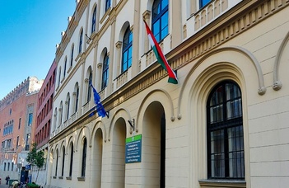
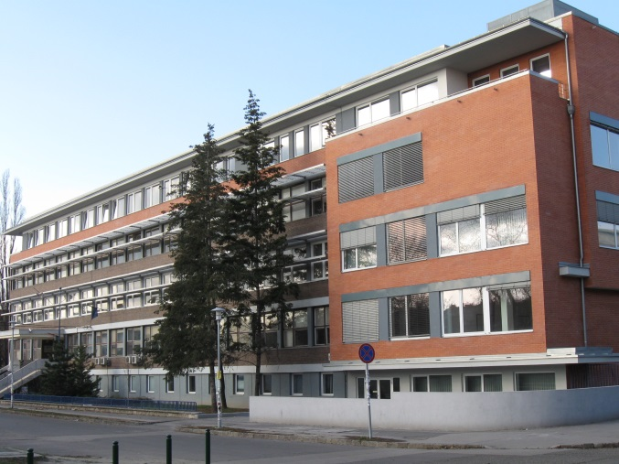
ELTE
BGE
Notes:
This is where – some nice memories

Slide 4
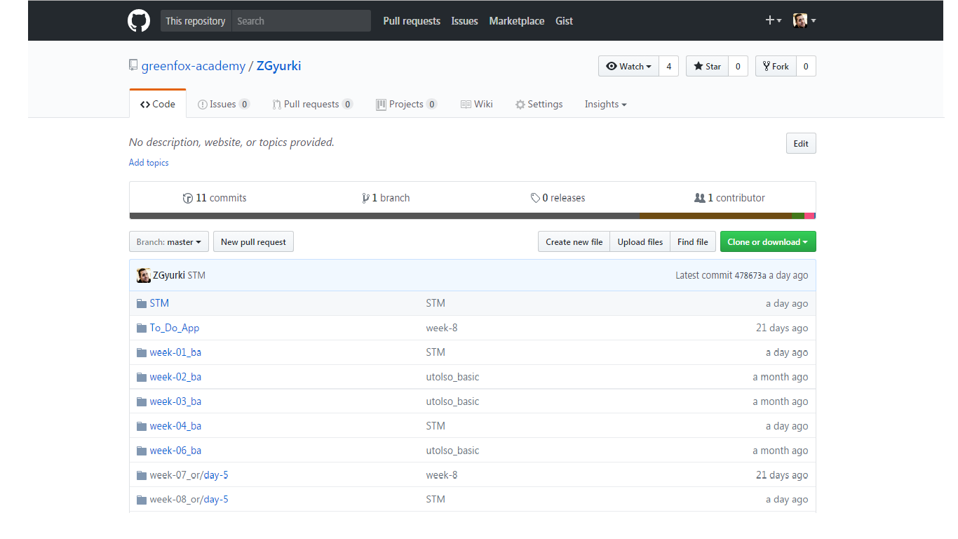
Notes:
Just the usual .. my repository

Slide 5
Stm32f7 - discovery
Notes:
This is the BOARD we are using day by day

Slide 6
First task

Slide 7
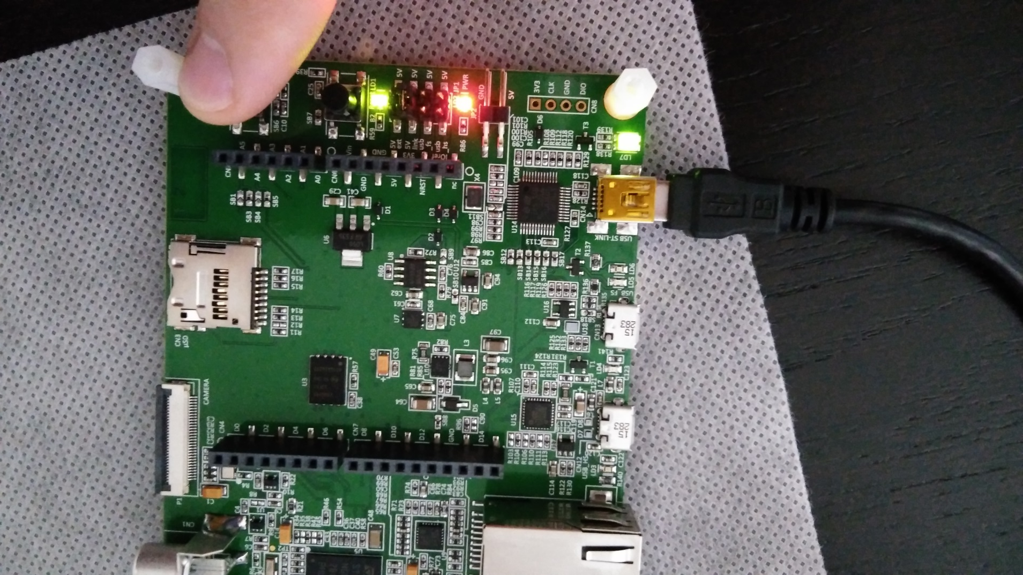
Notes:
Push the button and the led will light up

Slide 8
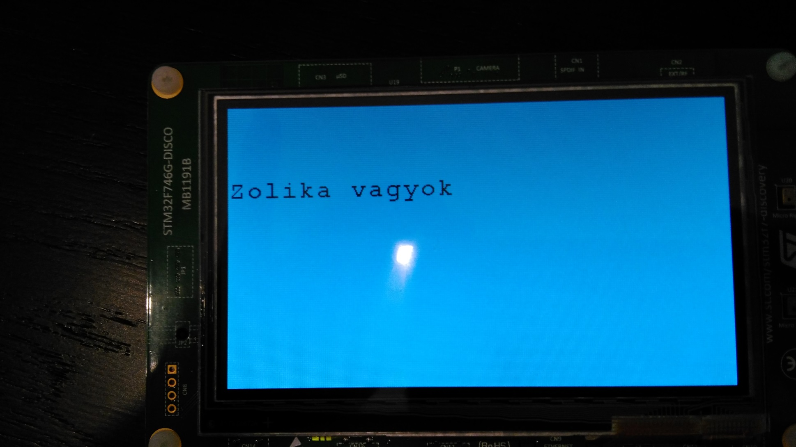
Notes:
Print out some text and moving

Slide 9
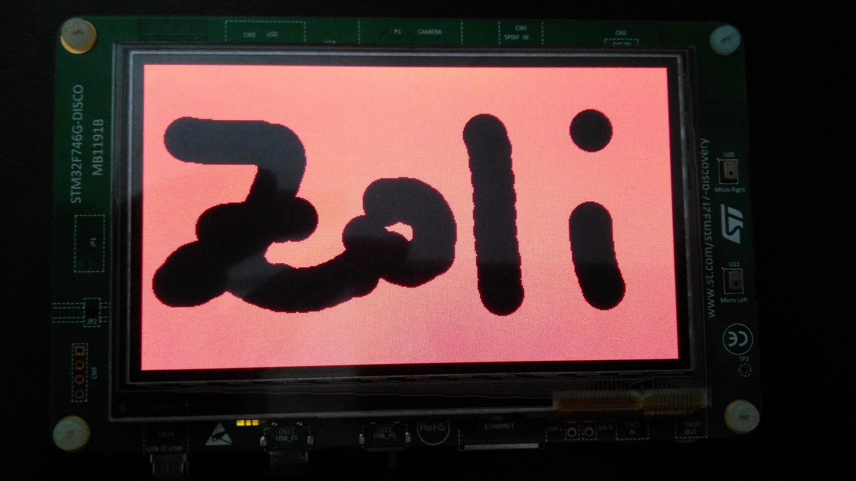
Notes:
Playing with colors, background, animation, shapes and touchscreen

Slide 10
Totoro Chat
Notes:
Our first bigger project – socket server, client and broadcasting

Slide 11
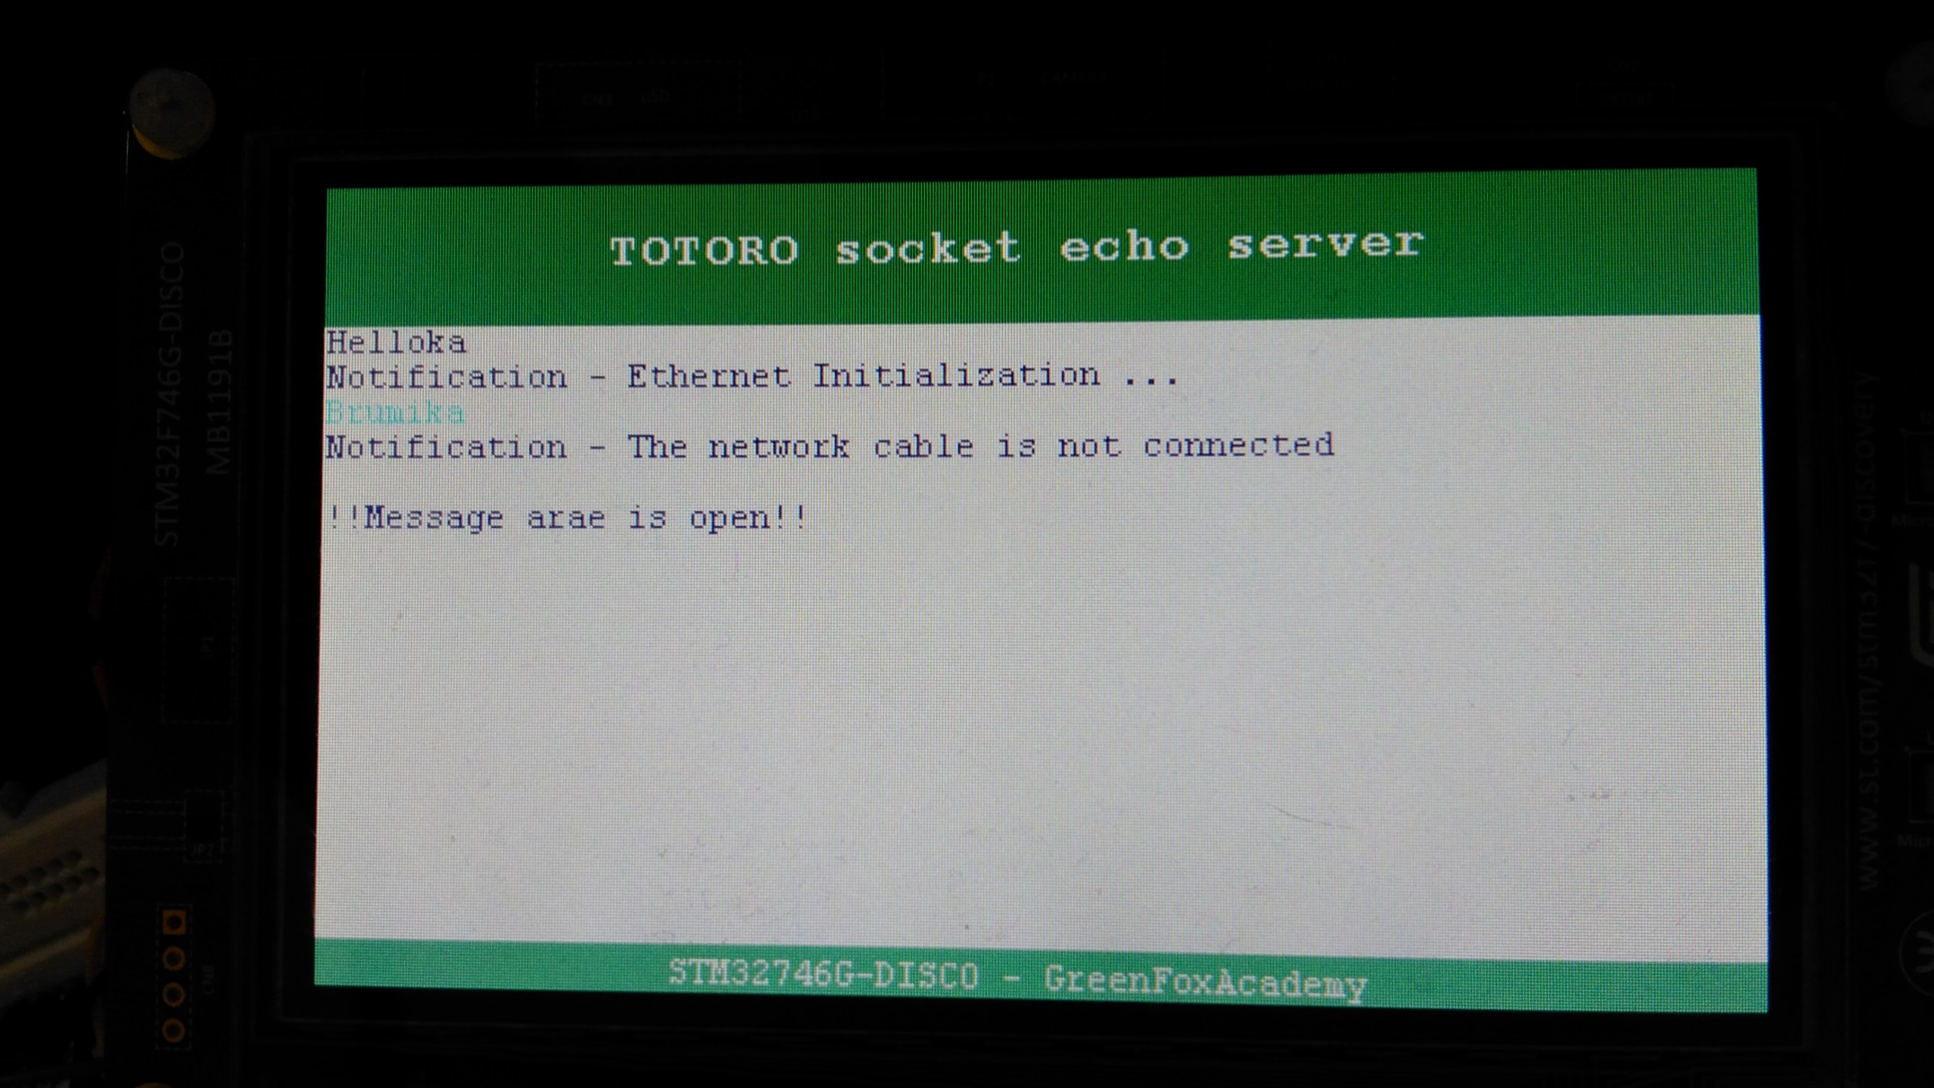
Notes:
Communication beetween board and computer -> or <- board and board
Sending messages with network usage -> send out the IP address, catch the an available partner (name and PORT number)
And let’s start messaging

Slide 12
tic-tac-toe

Slide 13
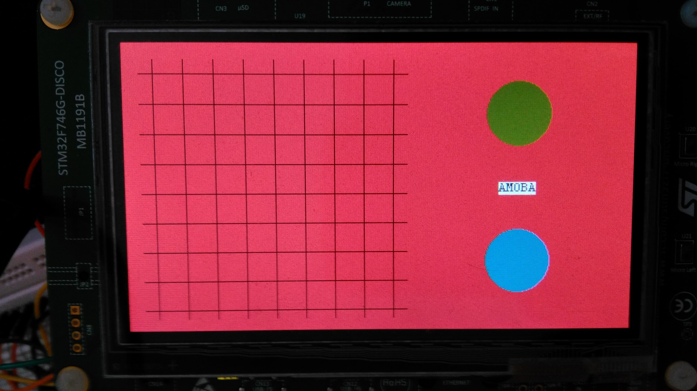
Notes:
It is something half finished (yet) – kind of beta app from FEDEX day/challenge
With two different area -> one for playing, and one for color picking
Two player mode

Slide 14
Led-matrix
Notes:
..finally the weekly project

Slide 15
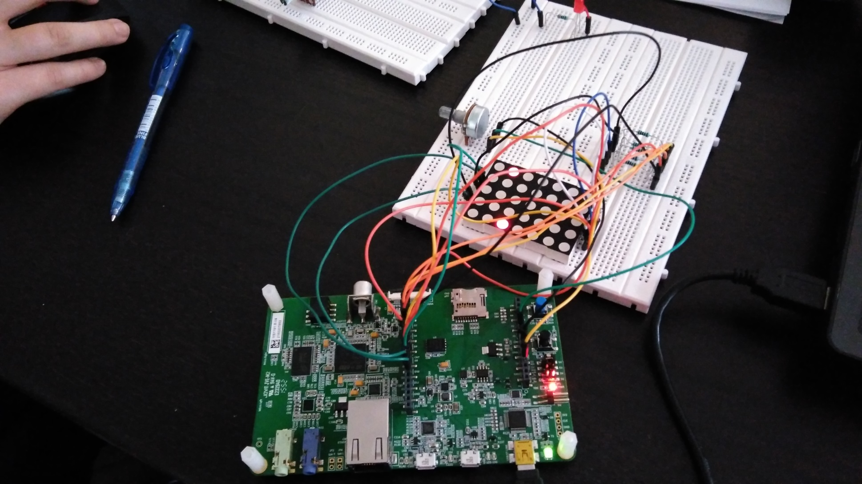
Notes:
Playing with a led-matrix

Slide 16
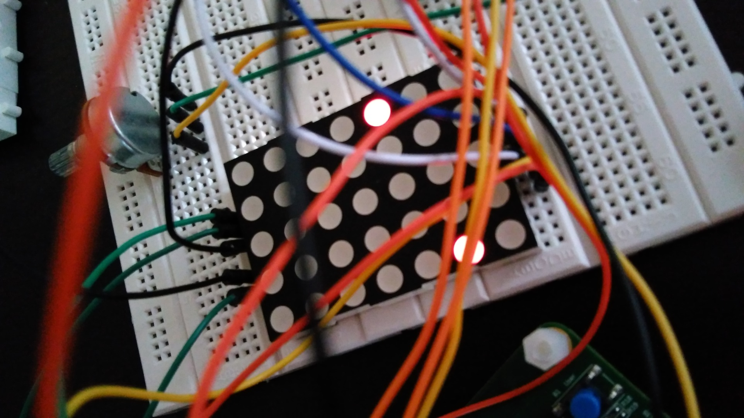
Notes:
Water fall animation
ADC measuring, using pot-meter for speed controlling
It will able to handle touches and write out different characters (letters, numbers, etc.)

Slide 17
summary

Slide 18
Really memorable
Joyful
Notes:
Im so happy now because I feel its going to be better and better
It was a fantastic period, and can’t wait for the next level

Slide 19
Thanks for your attention!

